Slide 1


C Programing
Prof. John Y. Chiang
Dept. of Computer Science & Engineering
National Sun Yat-sen University
chiang@cse.nsysu.edu.tw
http://image.cse.nsysu.edu.tw

Slide 2
Contents
1 C Overview
2 Selection and Decision
3 Repetition and Loops
4 Function
5 Arrays
6 Pointers I
7 Pointers II
8 Structure
9 Link list
10 Class and object

Slide 3

Lecture 6
Pointers I

Slide 4

Introduction
Pointers
    Powerful, but difficult to master
    Simulate call-by-reference
    Close relationship with arrays and strings

Slide 5


Pointer Variable Definitions and Initialization
Pointer variables
    Contain memory addresses as their values
    Normal variables contain a specific value
    (direct reference)
    Indirection – referencing a pointer value

Slide 6
Pointer Variable Definitions and Initialization
Pointer definitions
    * used with pointer variables
        int *myPtr;
    Defines a pointer to an int (pointer of type int *)
    Multiple pointers require using a * before each variable definition
        int *myPtr1, *myPtr2
    Can define pointers to any data type
    Initialize pointers to 0, NULL, or an address
        0 or NULL – points to nothing (NULL preferred)

Slide 7


Pointer Operators
& (address operator)
    Returns address of operand
        int y = 5;
        int *yPtr;
        yPtr = &y; /*yPtr gets address of y*/
        yPtr “points to” y

Slide 8
Pointer Operators
* (indirection/dereferencing operator)
    Returns a synonym/alias of what its operand points to
    *yptr returns y (because yptr points to y)
    * can be used for assignment
        Returns alias to an object
        *yptr = 7; /* changes y to 7 */
    Dereferenced pointer (operand of *) must be an lvalue (no constants)

Slide 9
Pointer Operators
* and & are inverses
    They cancel each other out
    *&yptr -> *(&yptr) -> *(address of yptr)->
    returns alias of what operand points to -> yptr
    &*yptr -> &(*yptr) -> &(y) ->
    returns address of y, which is yptr -> yptr

Slide 10
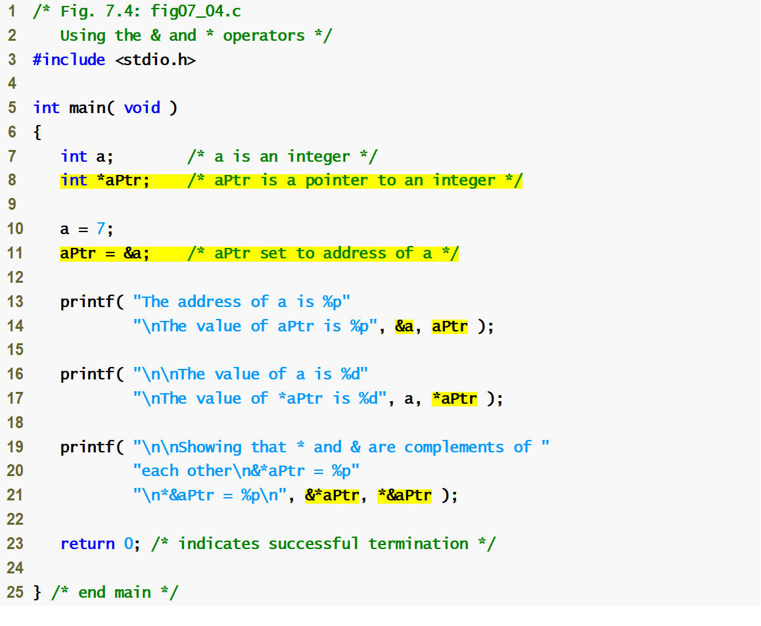
fig07_04.c
(1 of 2 )
If aPtr points to a, then &a and aPtr have the same value.
a and *aPtr have the same value
&*aPtr and *&aPtr have the same value

Slide 11
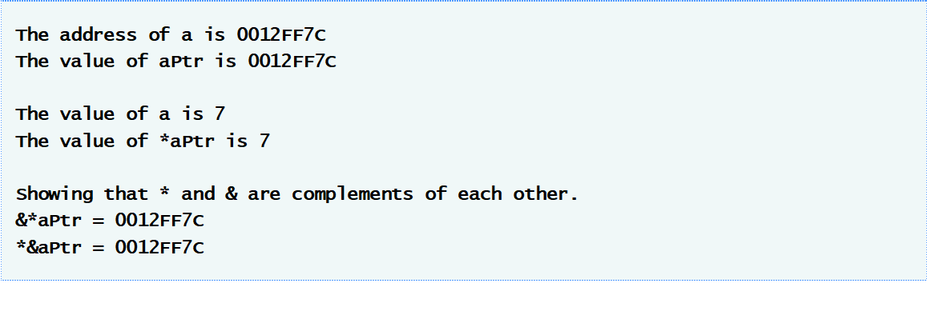
fig07_04.c
(2 of 2 )

Slide 12
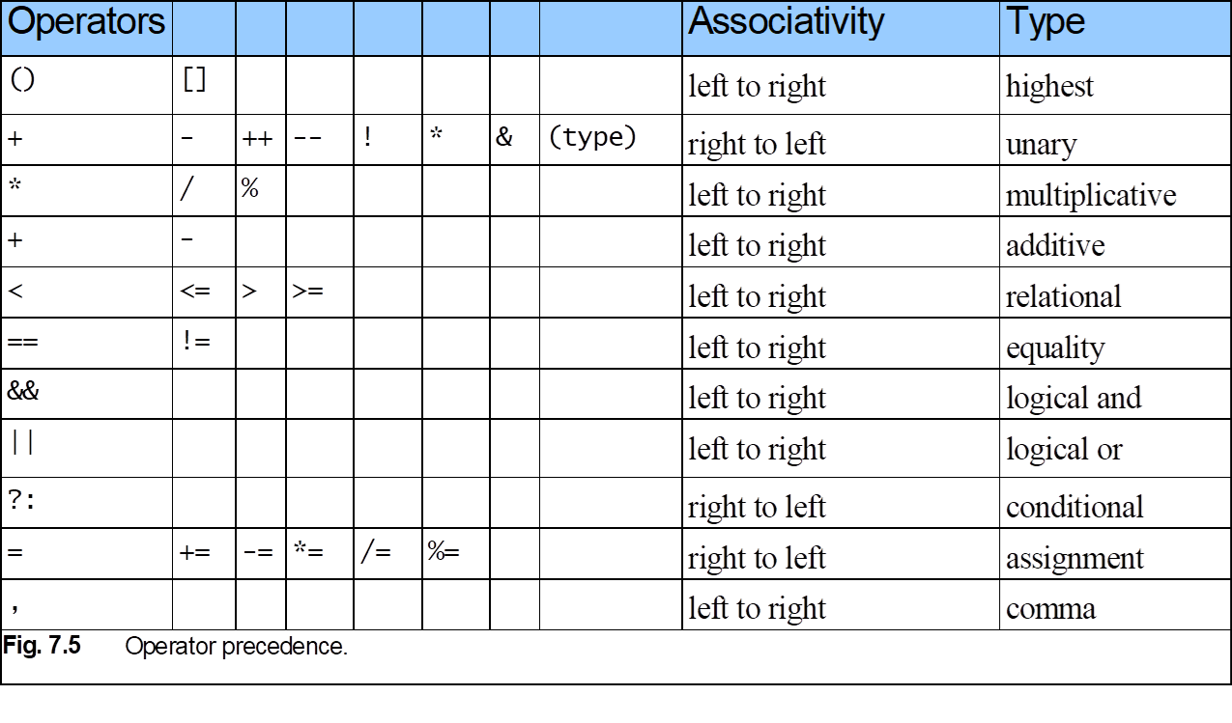
Pointer Operators

Slide 13
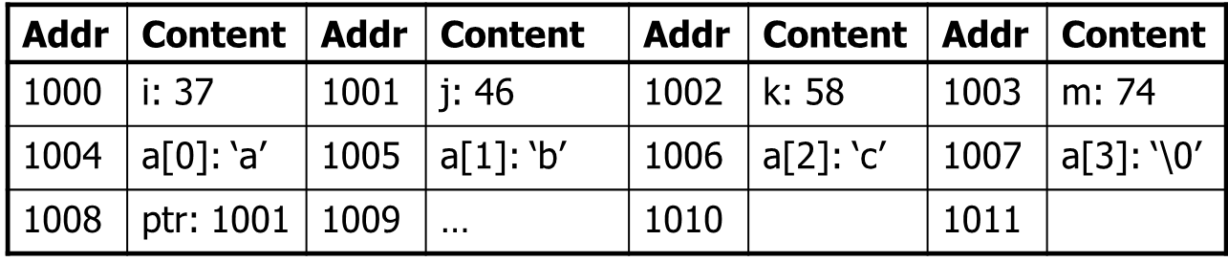
Computer Memory Revisited
Computers store data in memory slots
Each slot has an unique address
Variables store their values like this:

Slide 14
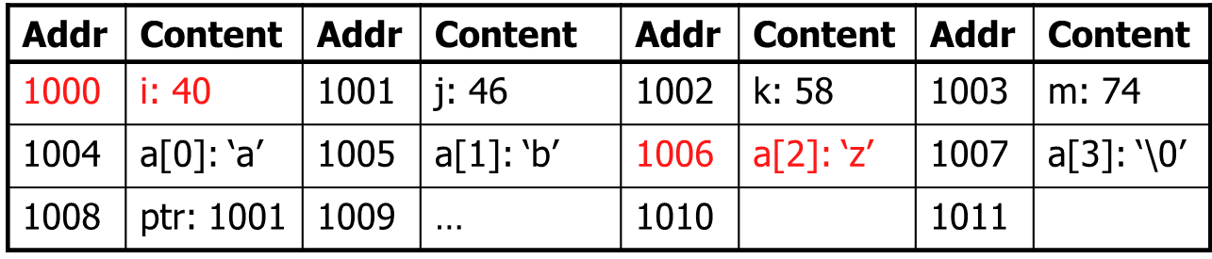
Computer Memory Revisited
Altering the value of a variable is indeed changing the content of the memory
    e.g. i = 40; a[2] = ‘z’;

Slide 15
Addressing Concept
Pointer stores the address of another entity
It refers to a memory location
int i = 5;
int *ptr; /* declare a pointer variable */
ptr = &i; /* store address-of i to ptr */
printf(“*ptr = %d\n”, *ptr); /* refer to referee of ptr */

Slide 16
Why do we need Pointer?
Simply because it’s there!
It is used in some circumstances in C
Remember this?
scanf(“%d”, &i);

Slide 17
What actually ptr is?
ptr is a variable storing an address
ptr is NOT storing the actual value of i
ptr
address of i
int i = 5;
int *ptr;
ptr = &i;
printf(“i = %d\n”, i);
printf(“*ptr = %d\n”, *ptr);
printf(“ptr = %p\n”, ptr);
i
5
Output:
i = 5
*ptr = 5
ptr = effff5e0
value of ptr = address of i
in memory

Slide 18
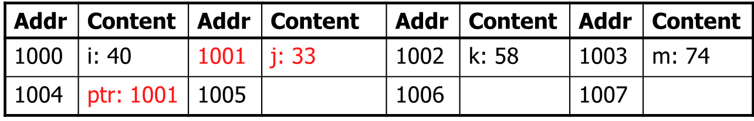
Twin Operators
&: Address-of operator
    Get the address of an entity
    e.g. ptr = &j;

Slide 19

Twin Operators
*: De-reference operator
    Refer to the content of the referee
    e.g. *ptr = 99;

Slide 20
Example: Using Pointers
int i1;
int i2;
int *ptr1;
int *ptr2;
i1 = 1;
i2 = 2;
ptr1 = &i1;
ptr2 = ptr1;
*ptr1 = 3;
i2 = *ptr2;
0x1014
…
0x1000
0x1010
ptr2:
0x100C
…
0x1000
0x1008
ptr1:
i2:
2
0x1004
3
i1:
3
0x1000
1

Slide 21
Example: Using Pointers
int int1 = 1036; /* some data to point to */
int int2 = 8;
int *int_ptr1 = &int1; /* get addresses of data */
int *int_ptr2 = &int2;
*int_ptr1 = int_ptr2;
*int_ptr1 = int2;
What happens?
Type check warning: int_ptr2 is not an int
int1 becomes 8

Slide 22
Example: Using Pointers
int int1 = 1036; /* some data to point to */
int int2 = 8;
int *int_ptr1 = &int1; /* get addresses of data */
int *int_ptr2 = &int2;
int_ptr1 = *int_ptr2;
int_ptr1 = int_ptr2;
What happens?
Type check warning: *int_ptr2 is not an int *
Changes int_ptr1 – doesn’t change int1

Slide 23
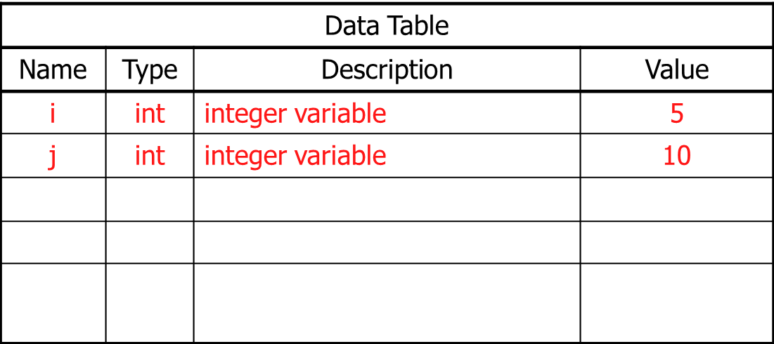
An Illustration
int i = 5, j = 10;
int *ptr;
int **pptr;
ptr = &i;
pptr = &ptr;
*ptr = 3;
**pptr = 7;
ptr = &j;
**pptr = 9;
*pptr = &i;
*ptr = -2;

Slide 24
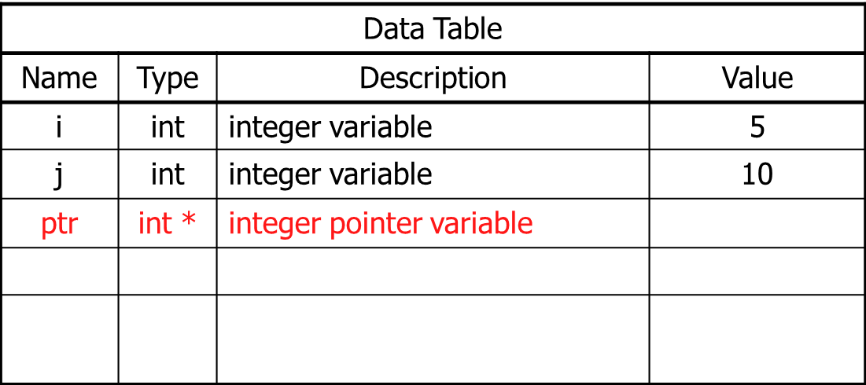
An Illustration
int i = 5, j = 10;
int *ptr; /* declare a pointer-to-integer variable */
int **pptr;
ptr = &i;
pptr = &ptr;
*ptr = 3;
**pptr = 7;
ptr = &j;
**pptr = 9;
*pptr = &i;
*ptr = -2;

Slide 25
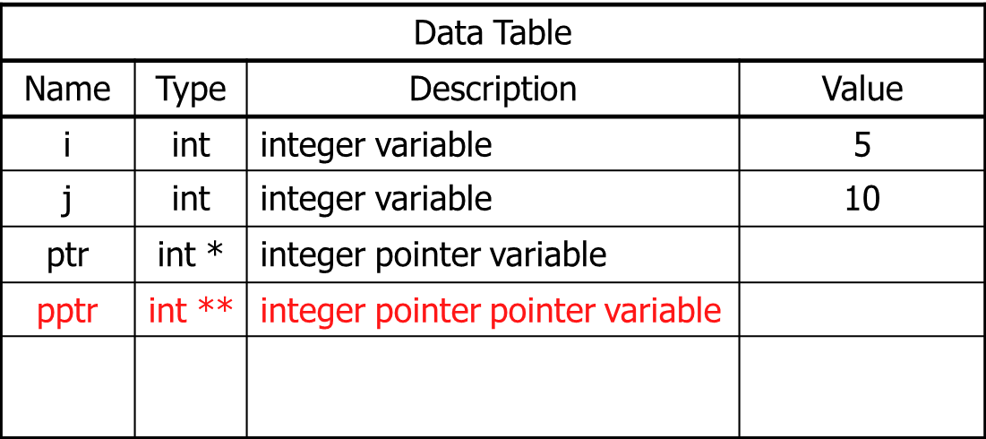
An Illustration
int i = 5, j = 10;
int *ptr;
int **pptr; /* declare a pointer-to-pointer-to-integer variable */
ptr = &i;
pptr = &ptr;
*ptr = 3;
**pptr = 7;
ptr = &j;
**pptr = 9;
*pptr = &i;
*ptr = -2;
Double direction

Slide 26
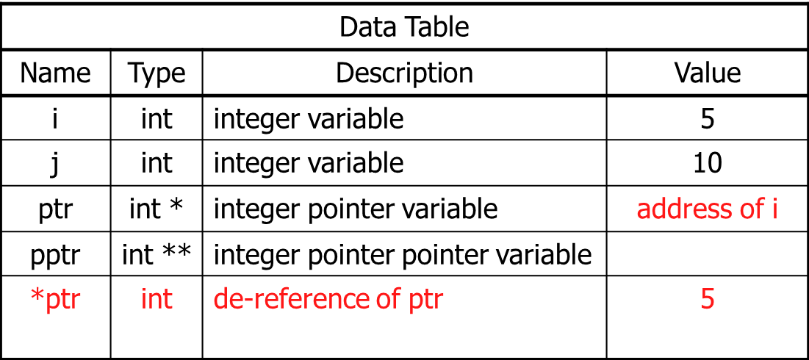
An Illustration
int i = 5, j = 10;
int *ptr;
int **pptr;
ptr = &i; /* store address-of i to ptr */
pptr = &ptr;
*ptr = 3;
**pptr = 7;
ptr = &j;
**pptr = 9;
*pptr = &i;
*ptr = -2;

Slide 27
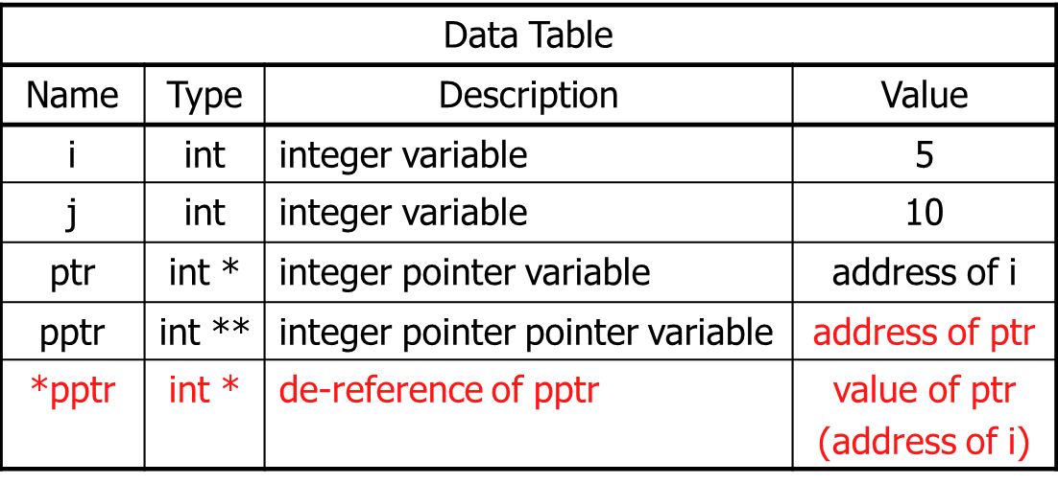
An Illustration
int i = 5, j = 10;
int *ptr;
int **pptr;
ptr = &i;
pptr = &ptr; /* store address-of ptr to pptr */
*ptr = 3;
**pptr = 7;
ptr = &j;
**pptr = 9;
*pptr = &i;
*ptr = -2;

Slide 28
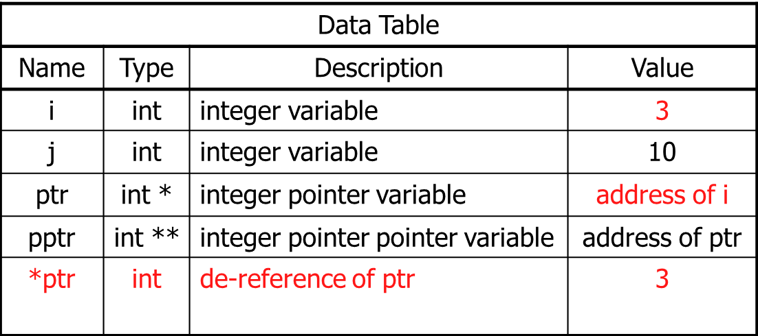
An Illustration
int i = 5, j = 10;
int *ptr;
int **pptr;
ptr = &i;
pptr = &ptr;
*ptr = 3;
**pptr = 7;
ptr = &j;
**pptr = 9;
*pptr = &i;
*ptr = -2;

Slide 29
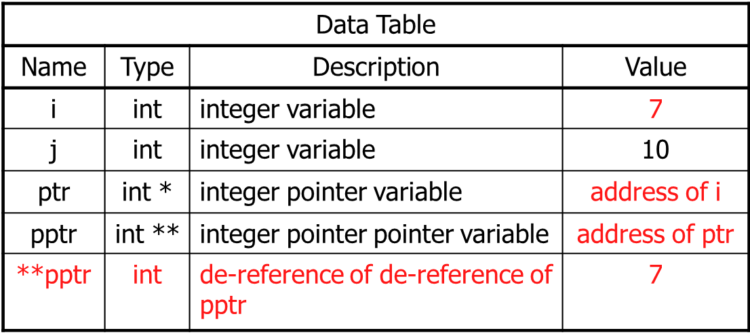
An Illustration
int i = 5, j = 10;
int *ptr;
int **pptr;
ptr = &i;
pptr = &ptr;
*ptr = 3;
**pptr = 7;
ptr = &j;
**pptr = 9;
*pptr = &i;
*ptr = -2;

Slide 30
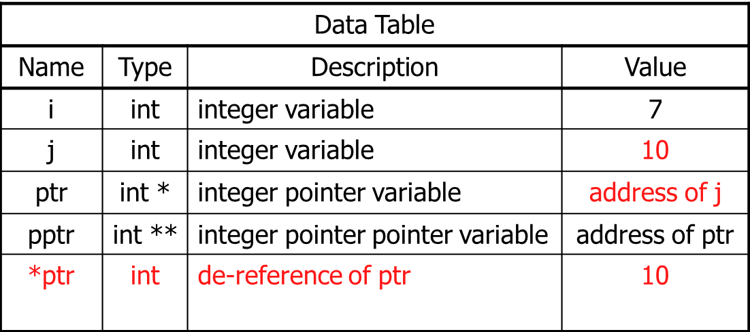
An Illustration
int i = 5, j = 10;
int *ptr;
int **pptr;
ptr = &i;
pptr = &ptr;
*ptr = 3;
**pptr = 7;
ptr = &j;
**pptr = 9;
*pptr = &i;
*ptr = -2;

Slide 31
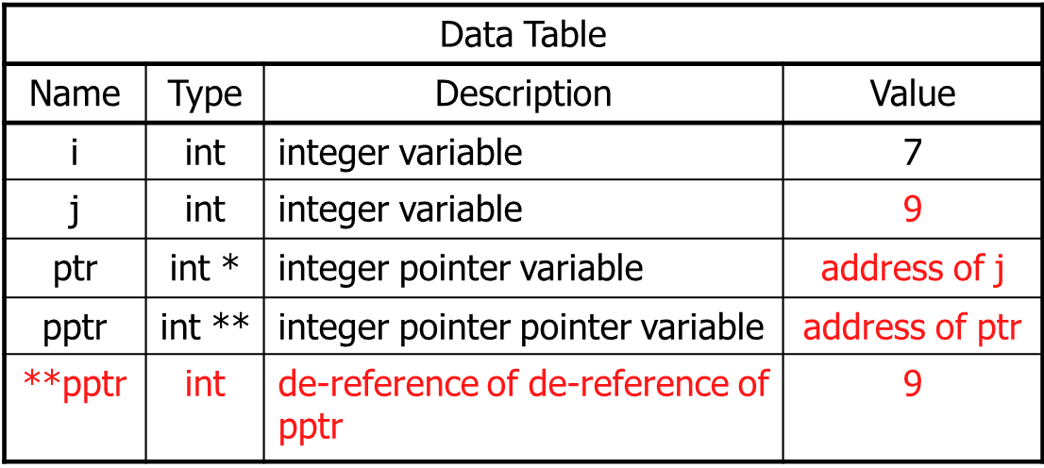
An Illustration
int i = 5, j = 10;
int *ptr;
int **pptr;
ptr = &i;
pptr = &ptr;
*ptr = 3;
**pptr = 7;
ptr = &j;
**pptr = 9;
*pptr = &i;
*ptr = -2;

Slide 32
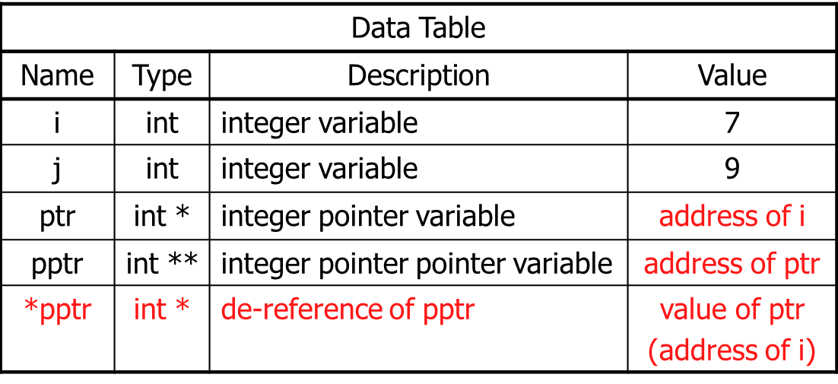
An Illustration
int i = 5, j = 10;
int *ptr;
int **pptr;
ptr = &i;
pptr = &ptr;
*ptr = 3;
**pptr = 7;
ptr = &j;
**pptr = 9;
*pptr = &i;
*ptr = -2;

Slide 33
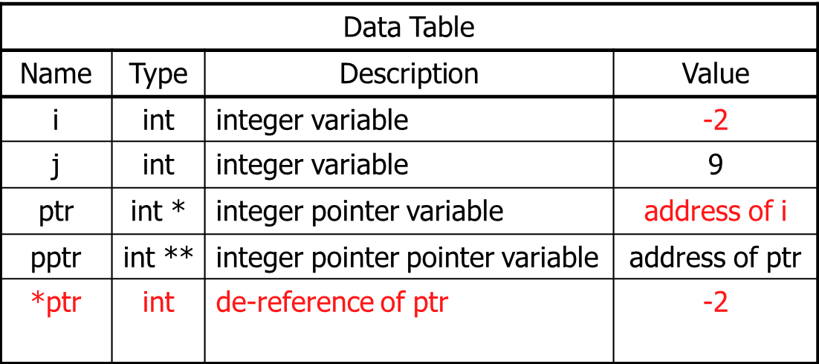
An Illustration
int i = 5, j = 10;
int *ptr;
int **pptr;
ptr = &i;
pptr = &ptr;
*ptr = 3;
**pptr = 7;
ptr = &j;
**pptr = 9;
*pptr = &i;
*ptr = -2;

